Slide 1

Arduino Course Session Three
Tank Movement, Servo Motor (& DC motor with encoders)

Slide 2
Session 2 - Recap
PWM
Serial Monitor
Transistors
Motor Driver IC

Slide 3
Session 3 Objective
Tank Movement
Servo Motor controlling
Reliable Push button input
DC Motor w/encoder controlling

Slide 4
Session 3 Objective – Part 1
How to interface with motor driver
Dual motor driving (in tinkercad)
Tank movement

Slide 5
Session 3 Objective – Part 2
How servo motor works
Practical Issue: Arduino Reset
How to control servo motor, how to change PWM frequency in analogWrite()
Practical Issue: non-accurate bounds
Servo motor Arduino built-in library
Other precise motors
Stepper motors
DC motors with encoders

Slide 6
Session 3 Objective – Part 3
How to read digital signal
Push button
Schematic and connection
Practical Problem: unreliable raw reading
Practical Problem: bouncing
Floating voltage
Pull-up & Pull-down Resistors
Reliable Push button reading

Slide 7
Session 3 Objective – Part 4
How to control DC motor with encoder
Reading the encoder
Function to move DC motor to a specified position

Slide 8
Session 3 – Part 1
How to interface with motor driver
Dual motor driving (in tinkercad)
Tank movement

Slide 9
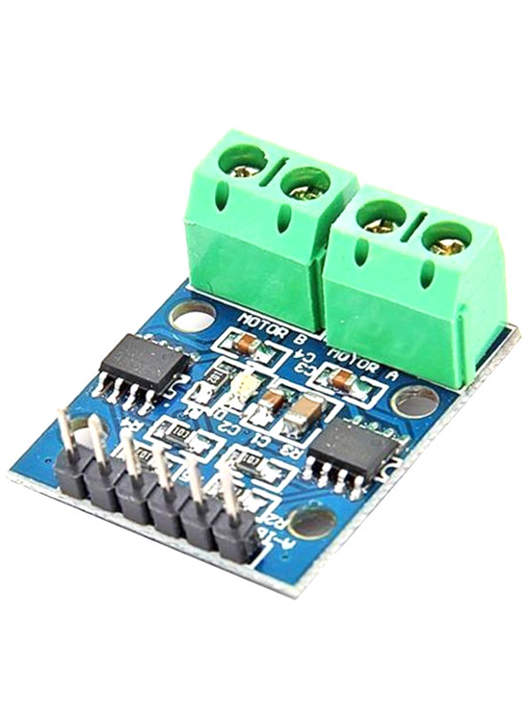
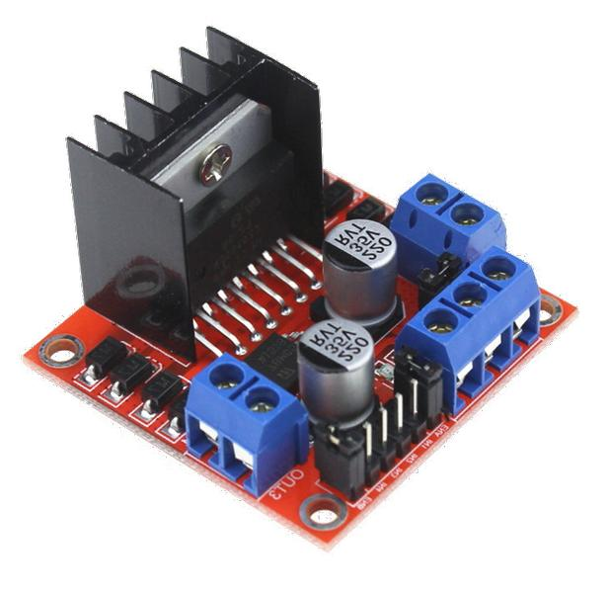
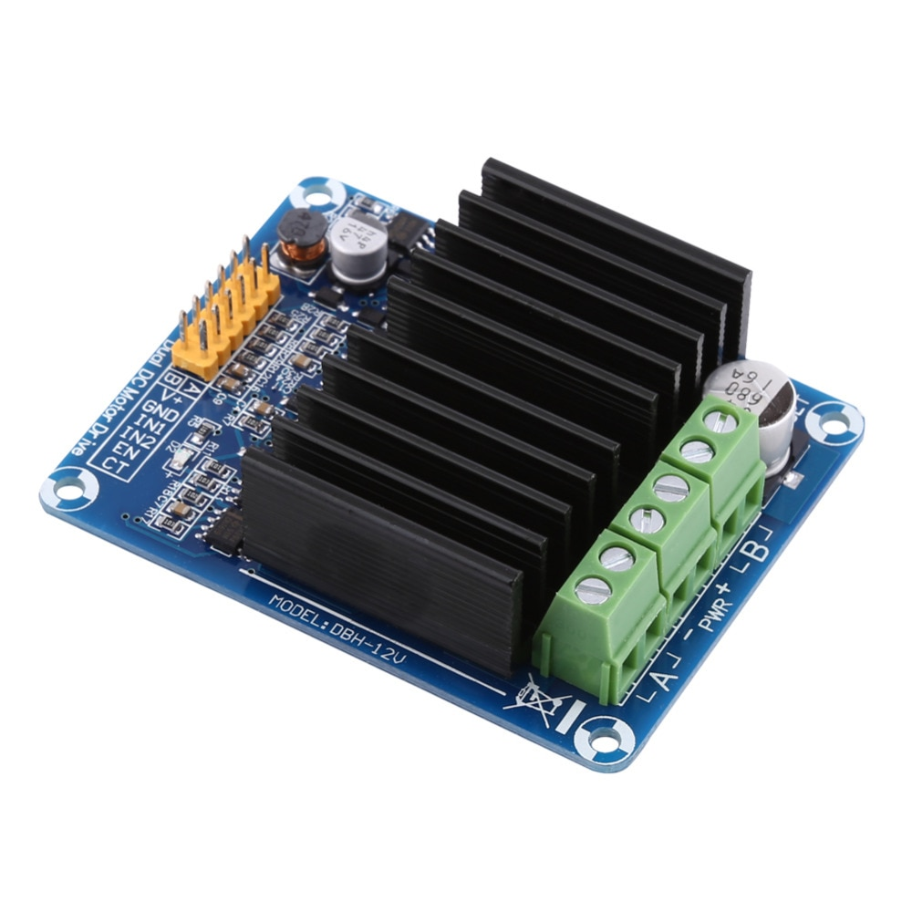
Motor Driver IC – How to interface with it

Slide 10
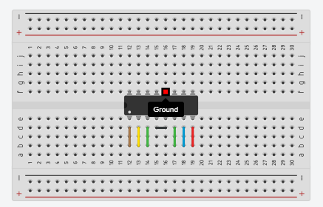
Motor Driver IC – How to interface with l293D

Slide 11
Motor Driver IC – How to interface with l293D
l293d datasheet from Texas instruments

Slide 12
Motor Driver IC – How to interface with l293D
Now Open tinkercad.com and start building the motor control

Slide 13
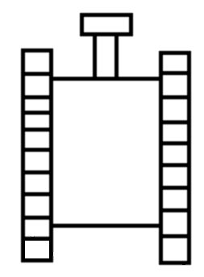
Dual Motor Tank Movement

Slide 14
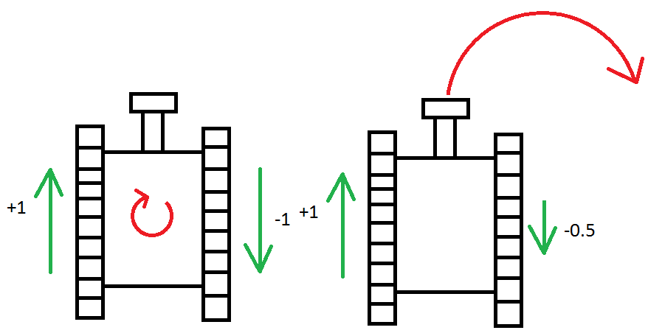
Dual Motor Tank Movement

Slide 15
Tank Movement Function
What is function (basically)
Defining
Calling
Passing parameters
How to control the tank movement easily

Slide 16
Dual Motor Tank Movement
The complete project will be postponed to an in-person class

Slide 17
Session 3 – Part 2
What is a servo motor
How servo motor works
Practical Issue: Arduino Reset
Servo motor Arduino built-in library

Slide 18

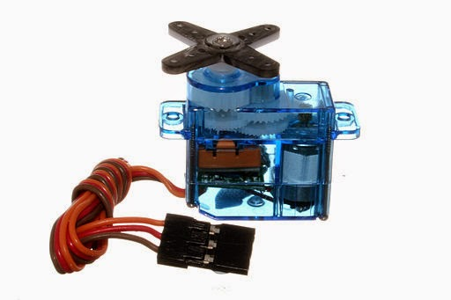
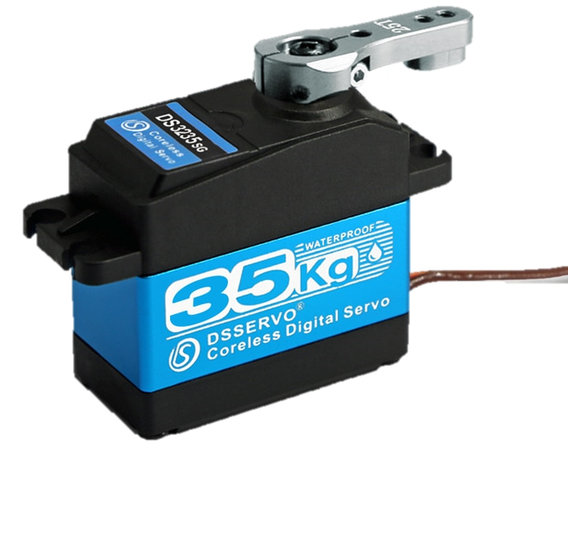
What is a servo motor
Motor controlled precisely based on control signal, either industrial or hobbyist

Slide 19
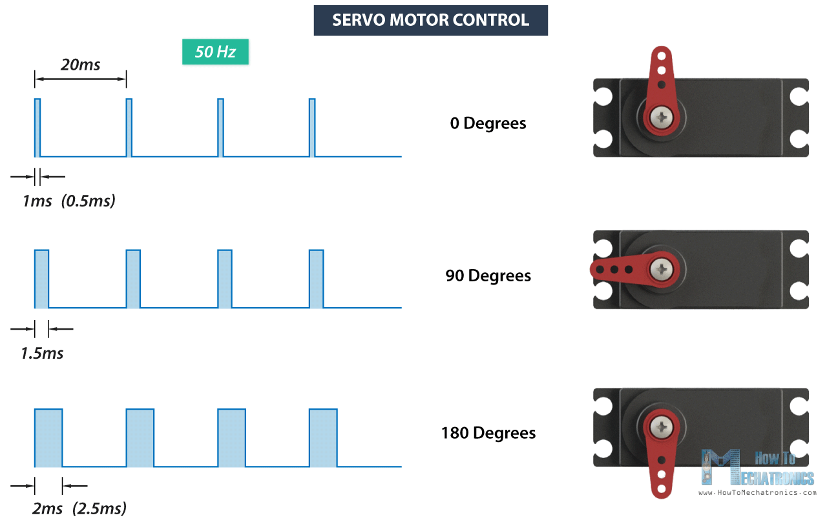
How servo motor works – Control Signal

Slide 20
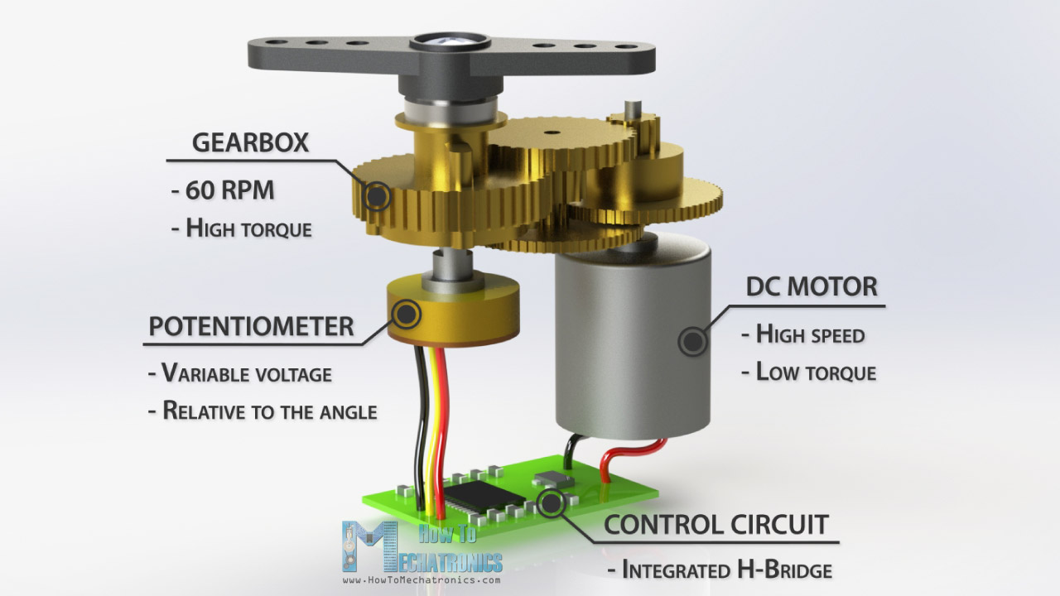
How servo motor works - Mechanism

Slide 21
Practical Issue: Power Dip (Voltage Sag)

Slide 22
How to control servo motor
Include servo library <Servo.h>
Setup Servo pin
Write PWM signal

Slide 23
Why servo library use software serial?
The implementation is more efficient than our version in previous session
Using Hardware PWM device require changing Arduino clock speed which is advanced and has a high performance hit
We can use hardware PWM, if interested we may discuss it and implement it at the end of the session

Slide 24
Session 3 – Part 2
Practical Issue: non-accurate bounds
Other precise motors
Stepper motors
DC motors with encoders

Slide 25

Practical Issue: non-accurate bounds
Due to manufacturing in-accuracies:
Servo.attach(pin, min-width, max-width)
Servo.writeMicroseconds($μ$S value)

Slide 26
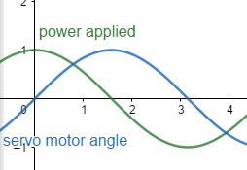
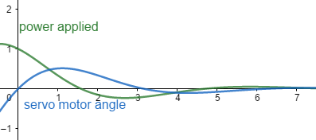
Practical Issue: jiggling (overshooting)
Basically this problem is unsolvable but also uncommon, a quick fix is to make sure the supplied voltage is accuratly 5 volts

Slide 27
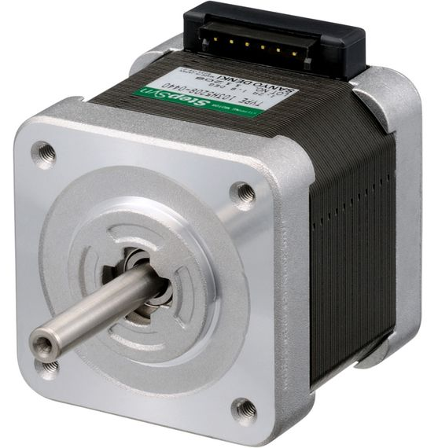
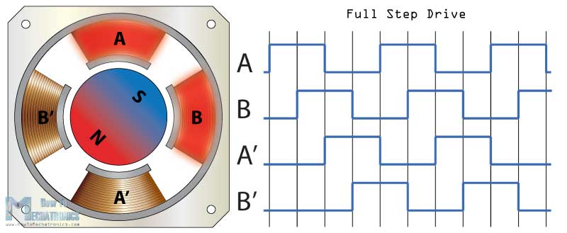
Other precise motors – Stepper Motors

Slide 28
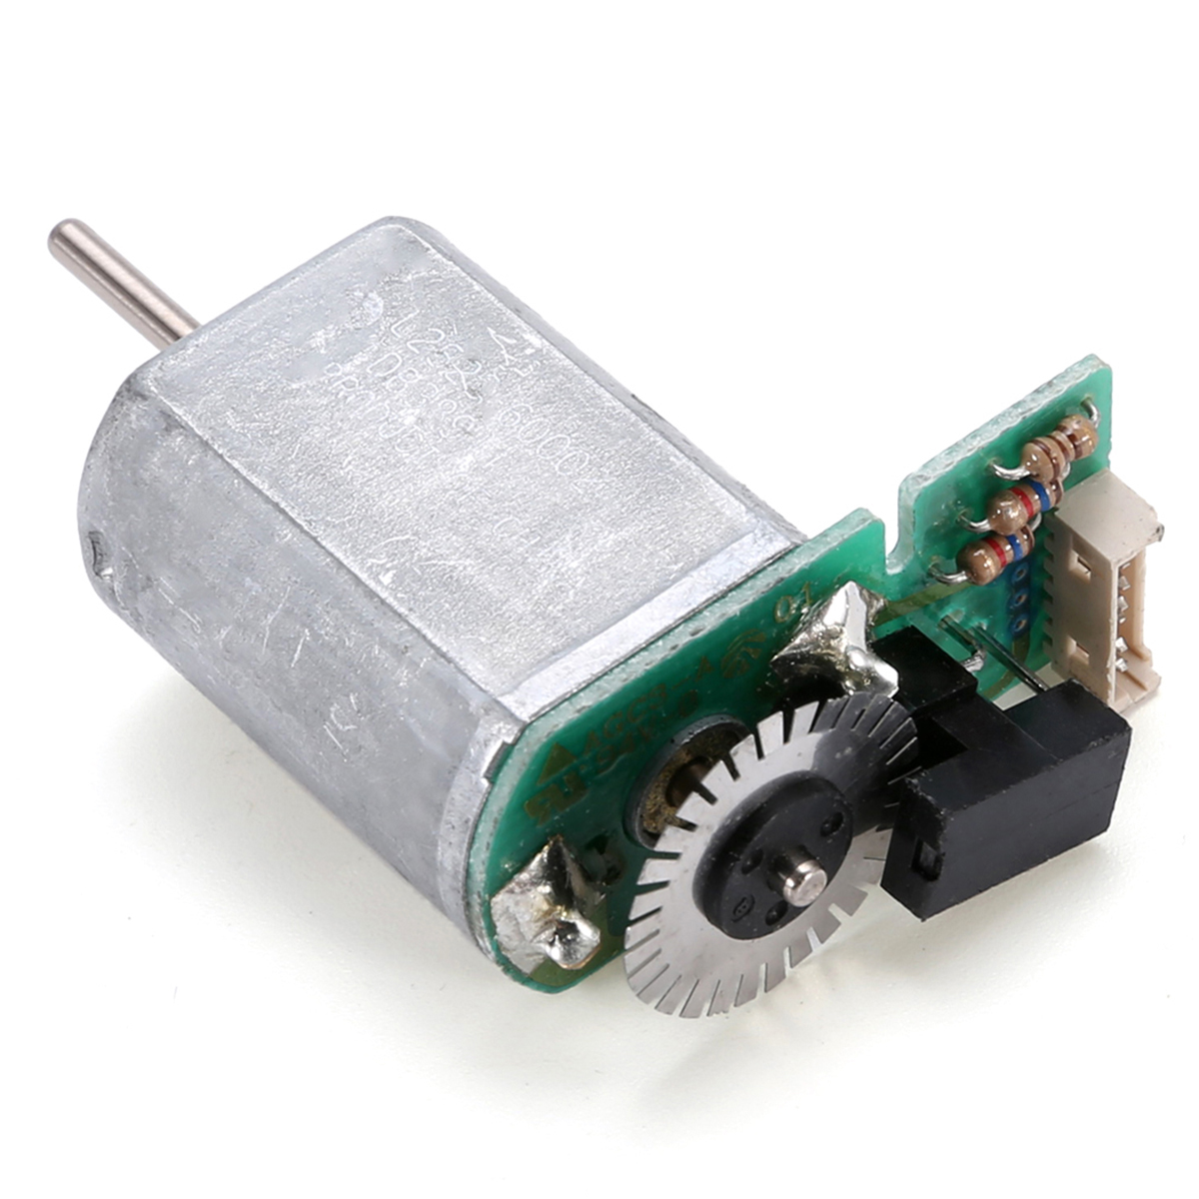
Other precise motors – DC motor with encoder
Simple to use
Cheap

Slide 29
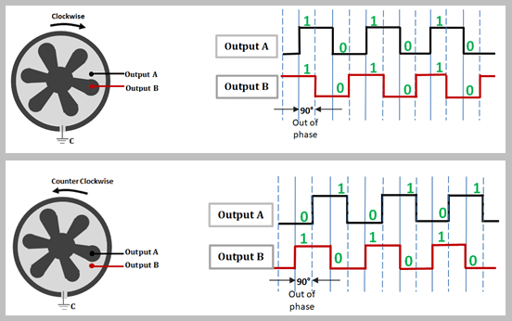
How to read DC motor encoder

Slide 30
Session 3 – Part 3
How to read digital signal
Push button
Schematic and connection
Practical Problem: unreliable raw reading
Practical Problem: bouncing

Slide 31
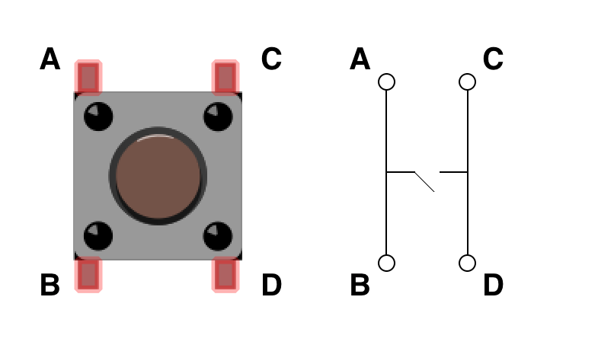
Push button

Slide 32
Practical Problem: unreliable raw reading
The current reading of push button

Slide 33
Practical Problem: unreliable raw reading
The desired reading of push button

Slide 34
Practical Problem: bouncing
Suppose we have desired limits of push button, this is our desired reading

Slide 35
Practical Problem: bouncing
But with solving the floating point problem, the actual reading of a single press will be

Slide 36
Session 3 – Part 3
Floating voltage
Pull-up & Pull-down Resistors
Reliable Push button reading

